Slide 1



The return at the Yeti

Slide 2

Agenda
1
Meet Our Best Team
Introduction
Objective
2
Unlocking insights
Retained Customers
Lost Customers
3
Game-changing
Model Implementation
Key Features
4
Conclusions

Slide 3


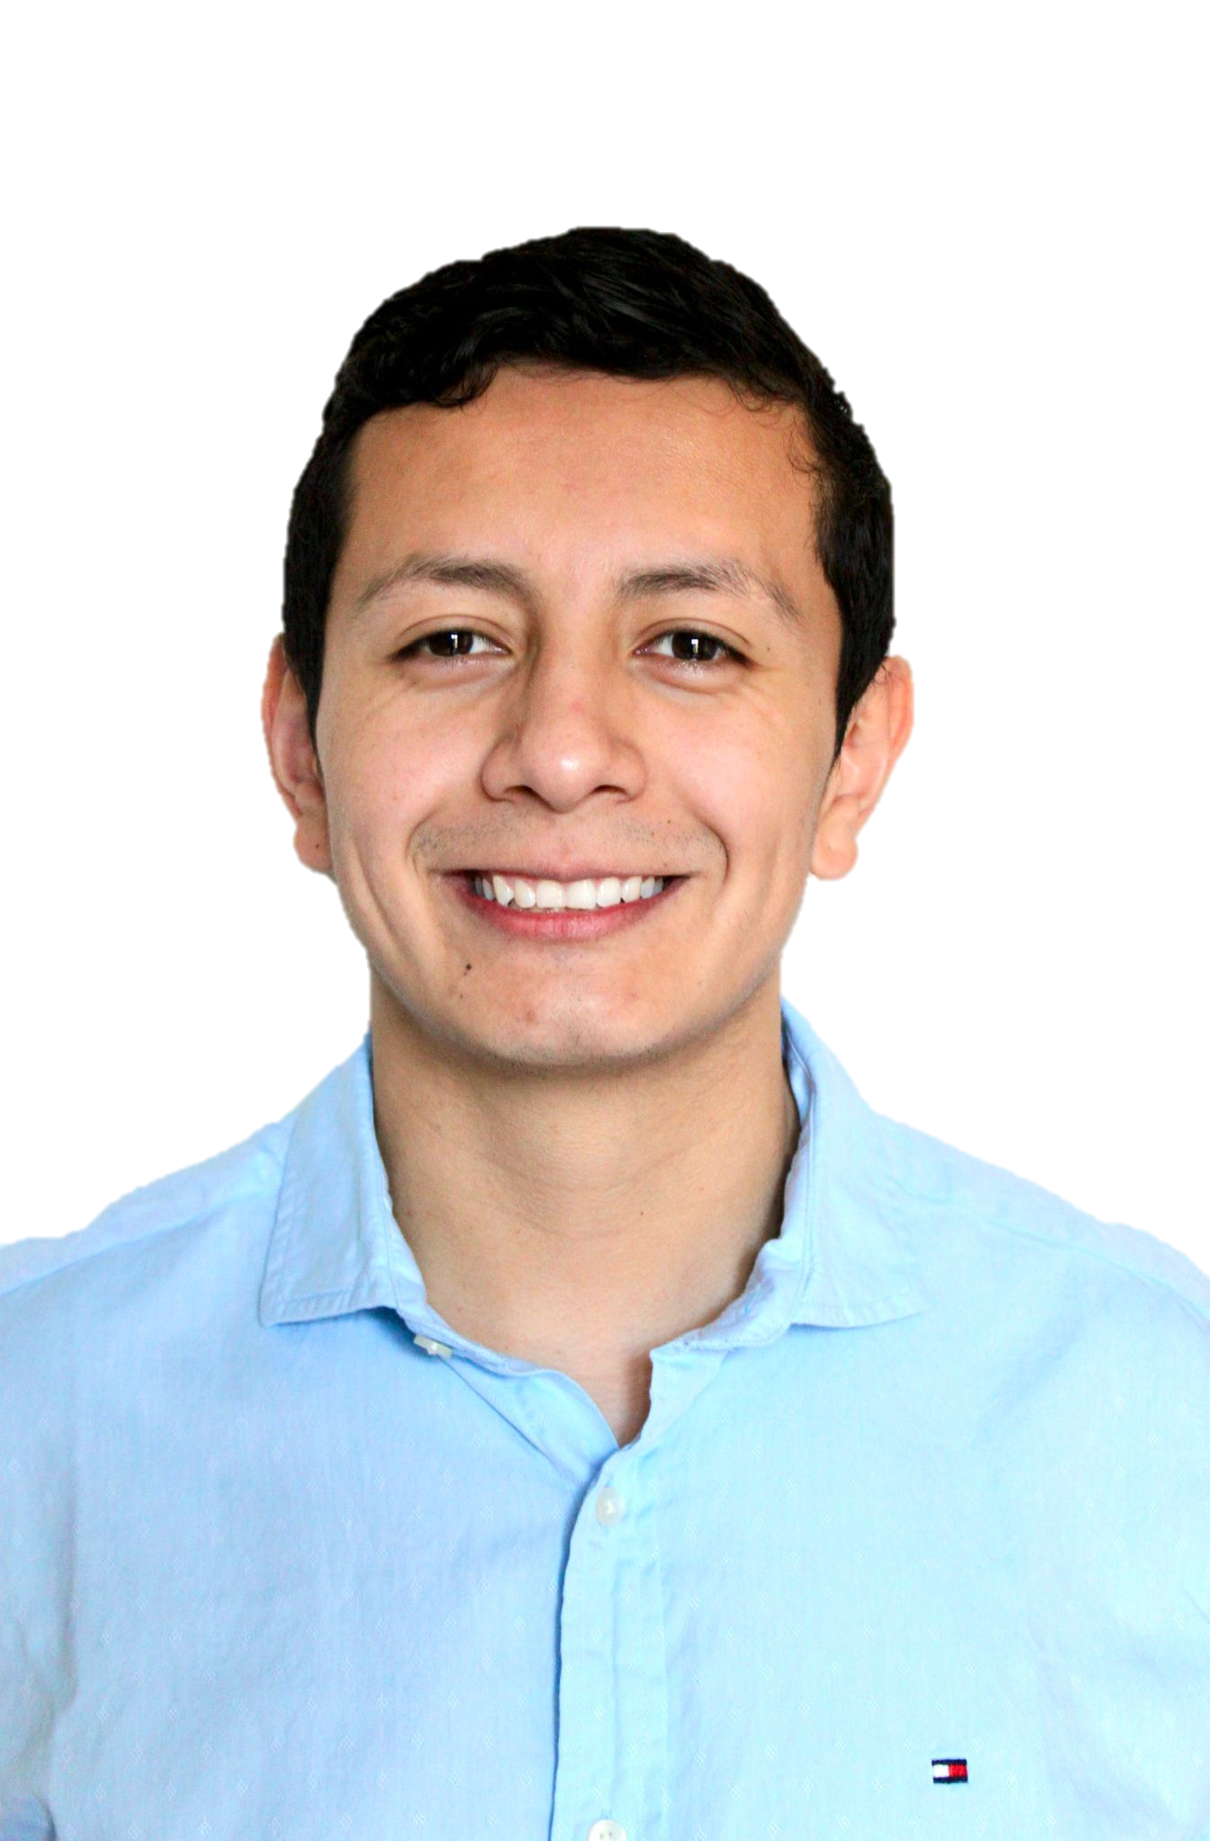

Meet Our Best Team
Federico Caccialanza
Michael Cáceres
Ricardo Díaz
Senior Data Scientist
Senior Data Guardian
Senior Business Intelligence Engineer

Slide 4

Objective
Identify the reasons for the drop in sales of the travel agency Yeti-Travel and to develop a predictive model to identify the most informative features that affect customer loyalty. The goal is to use this information to design specific measures to strengthen customer loyalty and ultimately improve sales.

Slide 5

Unlocking insights (Exploratory Analysis)

Slide 6
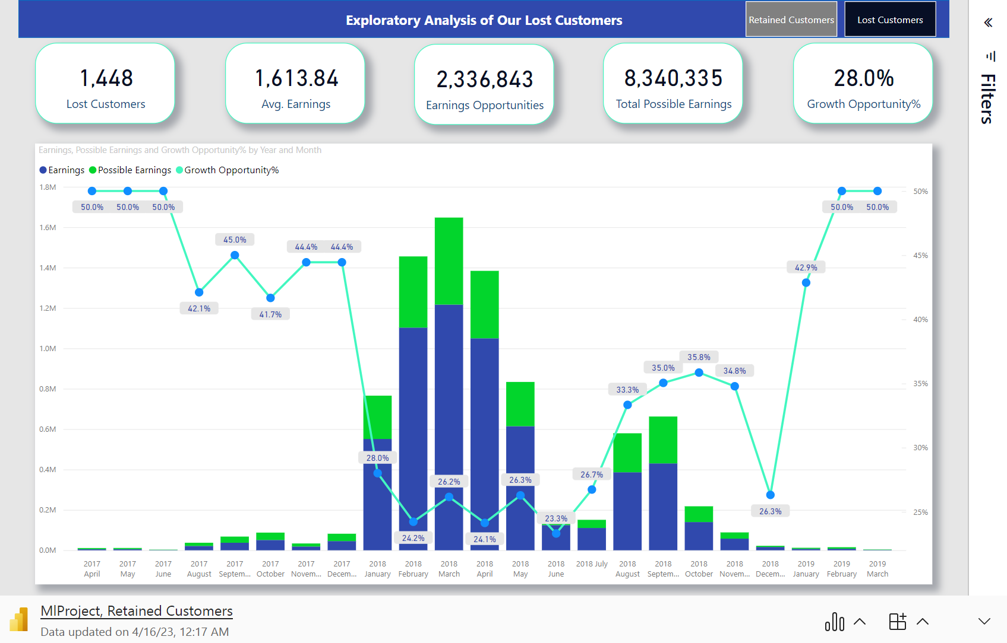

Slide 7

Game-changing Customer Retention

Slide 8




A New Solution for Customer Retention
3. Model Implementation
4. Predict, detect and Improve
1. Gathering Data
2. ETL
Sales Data
Finance Data
CRM Data

Slide 9


A Journey to Finding the Optimal Approach
Tested Models
Logistic Regression
Name
K-Neighbours
Logistic Regression
Decision Tree Classifier
Random Forest
Adaboost
Support Vector Machine
Naive Bayes
Gradient Boosting
Gradient Boosting
SVM

Slide 10

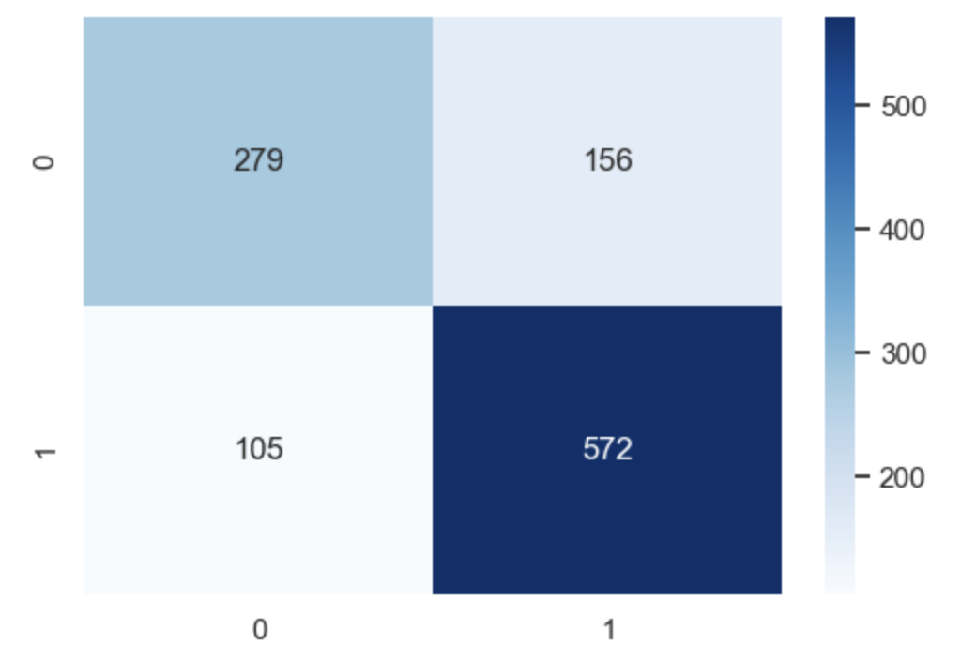
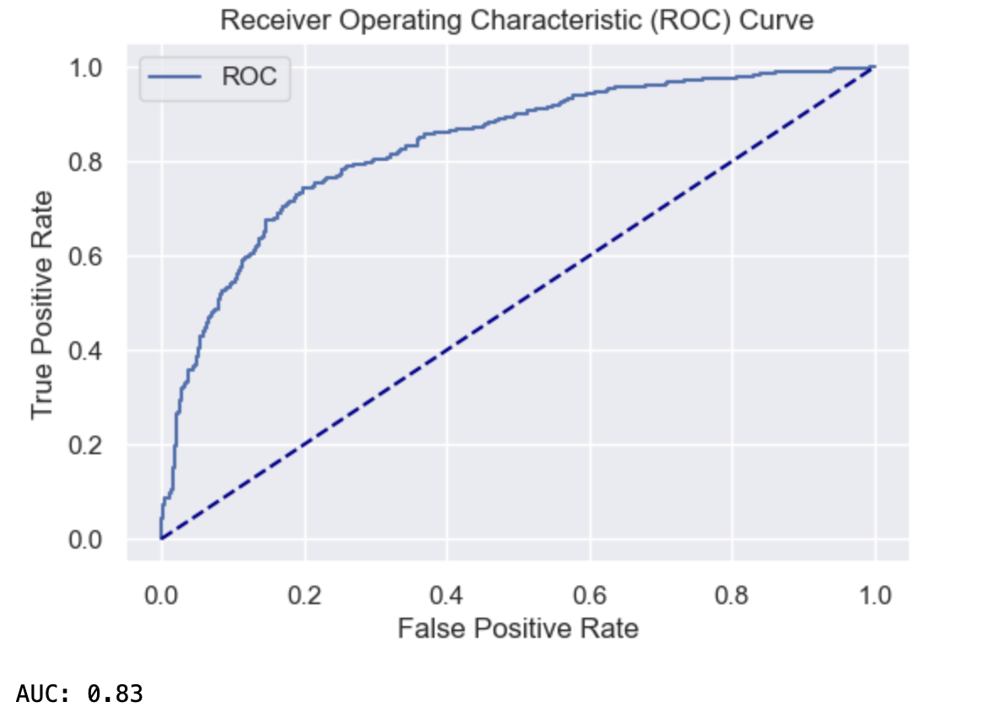
Evaluating Our Model
Results on train set
Precision | Recall | F1 score | Accuracy
0.81 | 0.86 | 0.83 | 0.79
Results on test set
Precision | Recall | F1 score | Accuracy
0.78 | 0.84 | 0.81 | 0.76
Confusion Matrix
Rox Curve

Slide 11

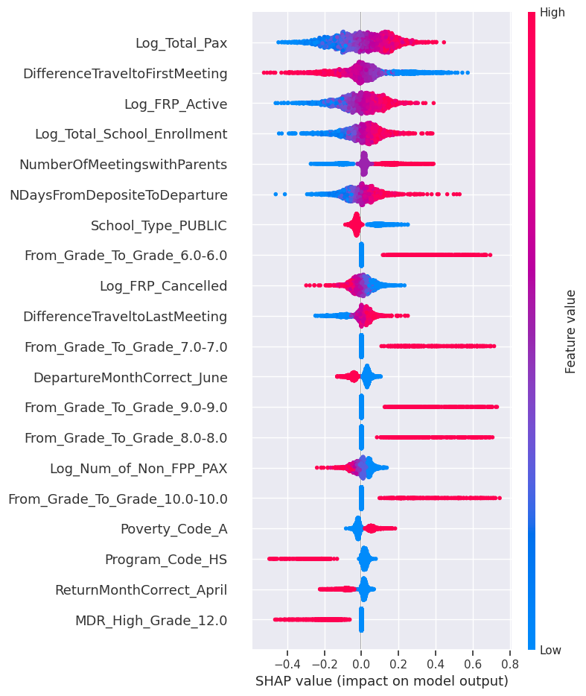
Identyfing our opportunities
Features importance:
Shap Values
Coefficient of Logistic Regression

Slide 12

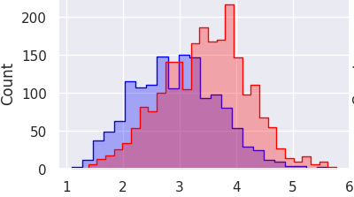
Must Influential Features
Student number
We observed that the coefficient of the feature which represents the number of total paying participants is 0.63.
In the figure we can see the logarithm of the number of total paying partecipants.

Slide 13

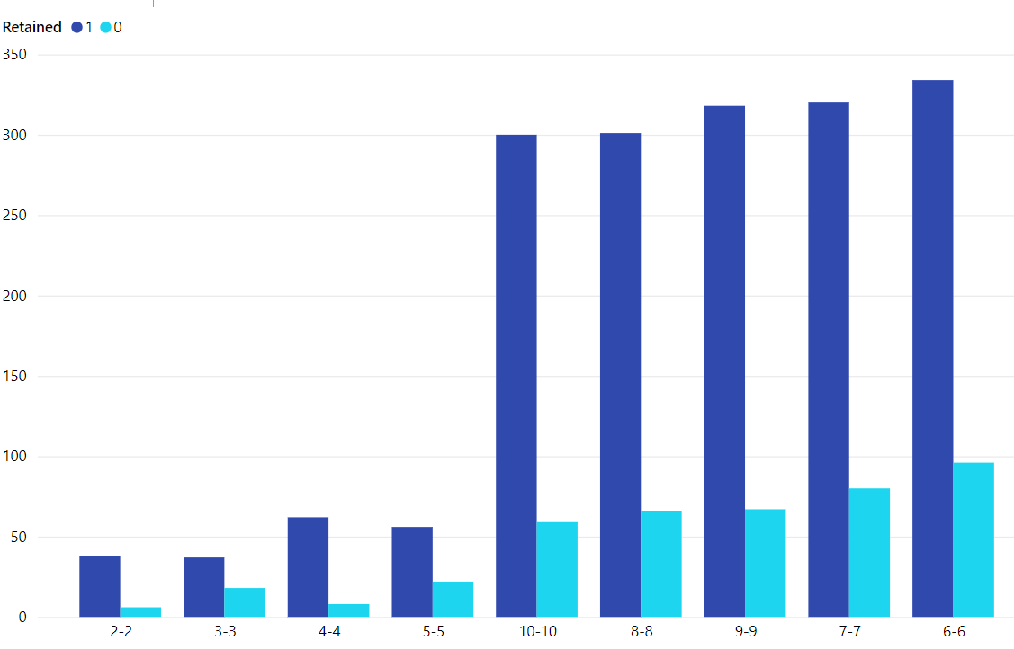
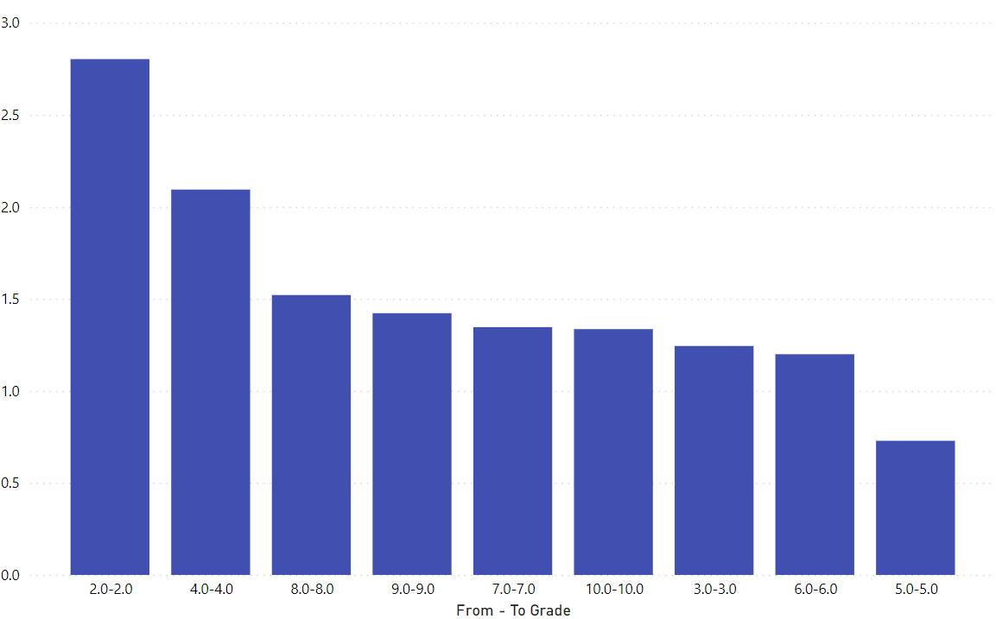
Must Influential Features
From Grade to Grade
We observed that every coefficient of the categorical variable from grade to grade in which the kids are of the same grade are positive and have a big importance as a feature in our model.

Slide 14

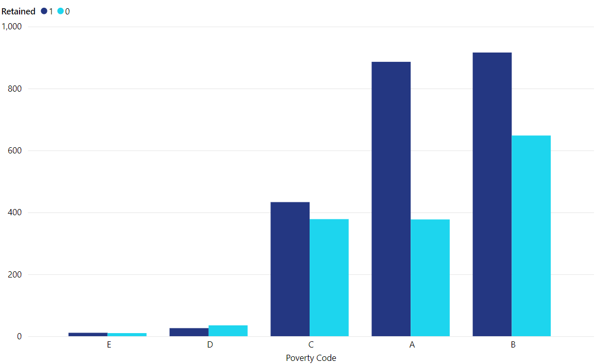
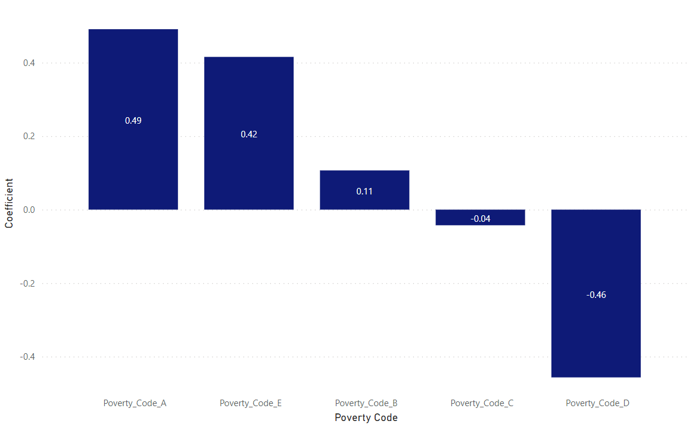
Must Influential Features
Poverty Code
The coefficients of the different poverty Classes have a big impact on our model.

Slide 15



Final Recomendations
Grade-Level Group Travel Packages
Consider prioritizing travel packages that cater to groups of students from the same grade level.
Increasing Paying Participants in School Trips
To maximize profitability, aim to organize trips with the highest possible number of paying participants. Encourage the sales team to cross-sell the trip to multiple classrooms within the same school and grade level.
Expanding Reach
Develop a new product offering specifically tailored for schools with limited purchasing power. By providing a more satisfactory offering to this segment, we can attract and retain clients who may have otherwise been lost.

Slide 16
Thanks!
Do you have any questions?

